Slide 1
Cloud-Based Data Processing
Data Centers
Jana Giceva
Notes:
Hi everyone, welcome to the introductory lecture for Cloud-based data processing. My name is Jana Giceva, I will be the lecturer for this course.
Unfortunately, due to the current situation we cannot meet in person and due to the internal departmental regulations, the lectures need to be pre-recorded so let me start by saying a few words about myself.

Slide 2
Datacenter Overview
Notes:
Today’s lecture is still somewhat an introductory lecture as I do not intend to dive too deep into the internals of datacenters, but nevertheless you need to have a broad knowledge of what datacenters how, how they are built, how they have evolved over the years, where they are headed and in principle understand how that affects the way we reason about building both system software and applications that run in the cloud on such datacenter computers.

Slide 3
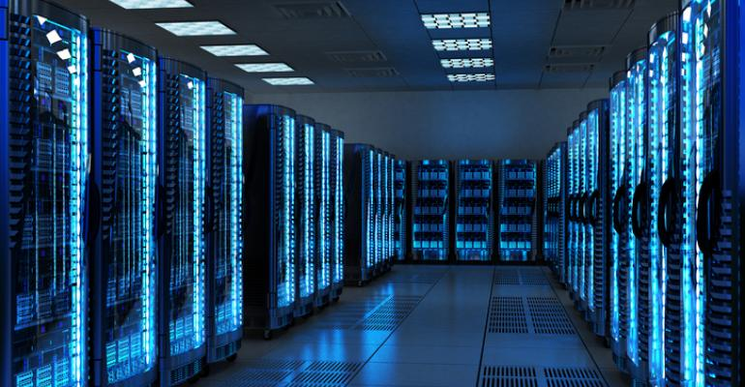
Data Centers
Data center (DC) is a physical facility that enterprises use to house computing and storage infrastructure in a variety of networked formats.
Main function is to deliver utilities needed by the equipment and personnel:
Power
Cooling
Shelter
Security
Size of typical data centers:
500 – 5000 sqm buildings
1 MW to 10-20 MW power (avg 5 MW)
Notes:
These new large datacenters cannot be viewed simply as a collection of collocated servers. Large portion of hardware and software resources in these facilities must work in concert to efficiently deliver good levels of internet service performance. →
Enterprises often treat a new datacenter as one massive warehouse scale computer.
The computing platform required for such large scale services consists of 1000s of computing nodes, with their corresponding networking and storage sub-systems, power distribution ad conditioning equipment, and extensive cooling systems.

Slide 4
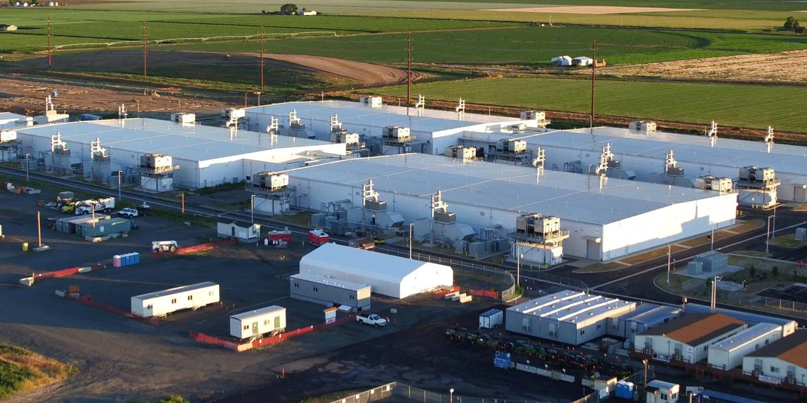
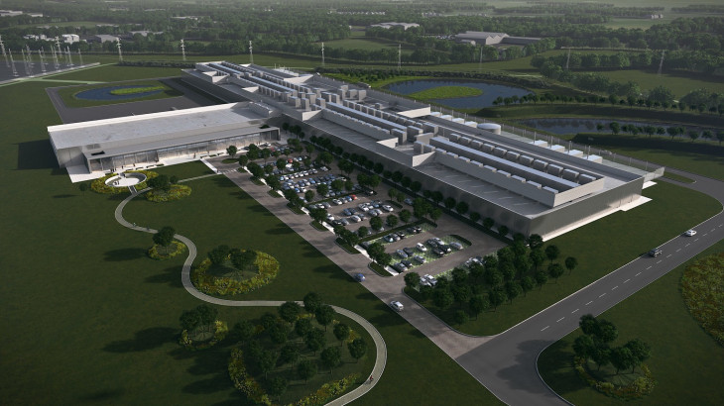
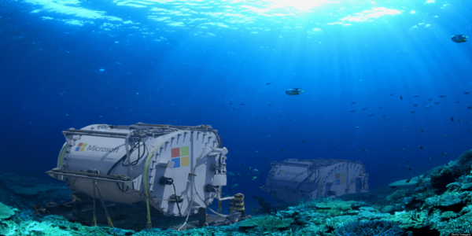
Example data centers

Slide 5
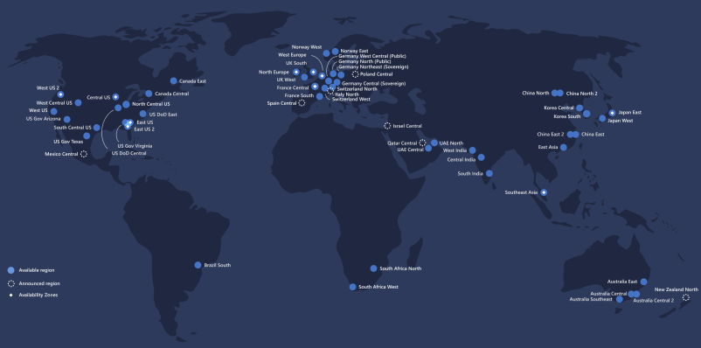
Datacenters around the globe
https://docs.microsoft.com/en-us/learn/modules/explore-azure-infrastructure/2-azure-datacenter-locations
Notes:
Azure has more regions than any other cloud provider more than 60, 160k miles of fiber and undersea cables connections between the regions
1M+ miles of fiber cable per datacenter

Slide 6
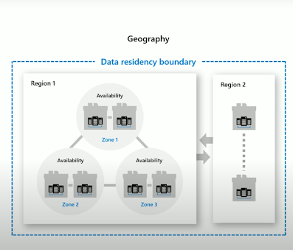
Modern DC for the Cloud architecture
Geography:
Two or more regions
Meets data residency requirements
Fault-tolerant from complete region failures
Region:
Set of datacenters within a metropolitan area
Network latency perimeter < 2ms
Availability Zones:
Unique physical locations within a region
Each zone made up of one or more DCs
Independent power, cooling, networking
Inter-AZ network latency < 2ms
Fault tolerance from DC failure
Src: Inside Azure Datacenter Architecture with Mark Russinovich

Slide 7
Data Centers
Traditional data centers
Host a large number of relatively small- or medium-sized applications, each running on a dedicated hardware infrastructure that is decoupled and protected from other systems in the same facility
Usually for multiple organizational units or companies
Modern data centers (a.k.a., Warehouse-scale computers)
Usually belong to a single company to run a small number of large-scale applications
Google, Facebook, Microsoft, Amazon, Alibaba, etc.
Use a relatively homogeneous hardware and system software
Share a common systems management layer
Sizes can vary depending on needs

Slide 8
Datacenter Architecture

Slide 9
Scale-up vs. scale-out
Scale-up: high cost powerful CPUs, more cores, more memory
Scale-out: adding more low cost, commodity servers
Supercomputer vs. data center
Scale
Blue waters = 40K 8-core “servers”
Microsoft Chicago Data centers = 50 containers = 100K 8-core servers
Network architecture
Supercomputers: InfiniBand, low-latency, high bandwidth protocols
Data Centers: (mostly) Ethernet based networks
Storage
Supercomputers: separate data farm
Data Centers: use disk on node + memory cache

Slide 10
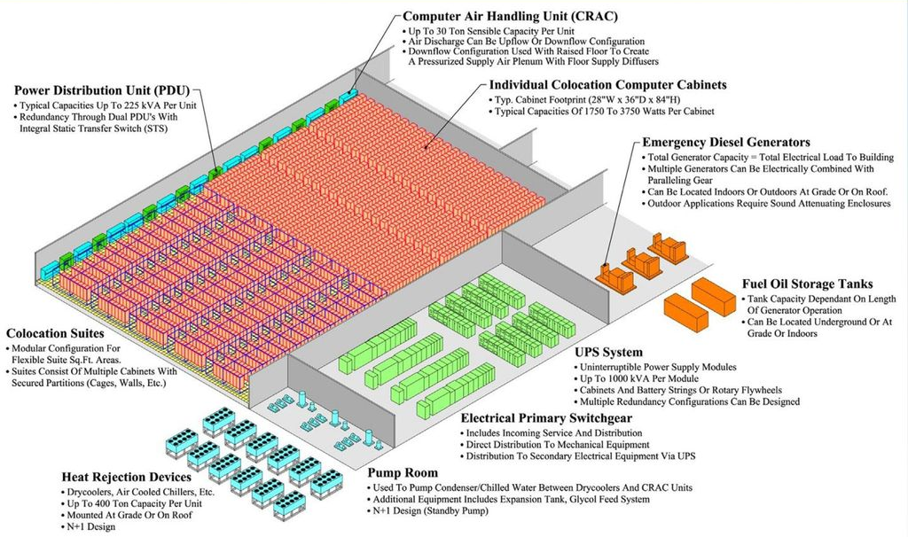
Main components of a datacenter
src: The Datacenter as a Computer – Barroso, Clidaras, Holzle
Notes:
Power subsystem
Uninterruptable power supplies (UPS)
Ventilation and cooling systems
Backup generators
Cabling to connect to external network operators
Routers, switches, security devices, storage systems, servers, application delivery controllers, and more.
Reliability, efficiency, security, and constant evolution of a datacenter are typically a top priority.

Slide 11
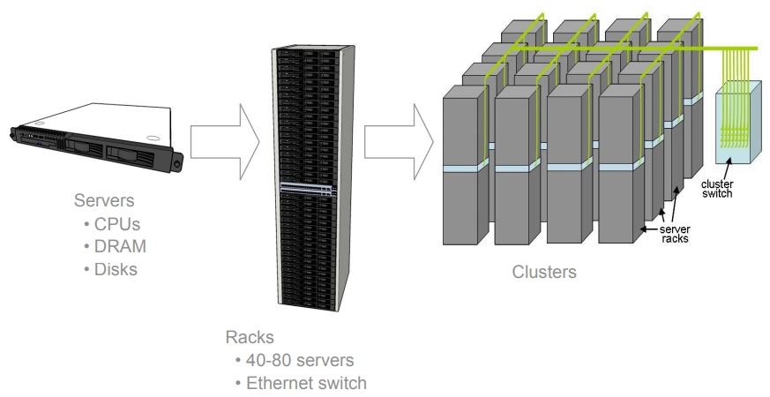
Traditional Data Center Architecture
Servers mounted on 19’’ rack cabinets
Racks are placed in single rows forming corridors between them.
Src: the datacenter as a computer – an introduction to the design of warehouse-scale machines

Slide 12
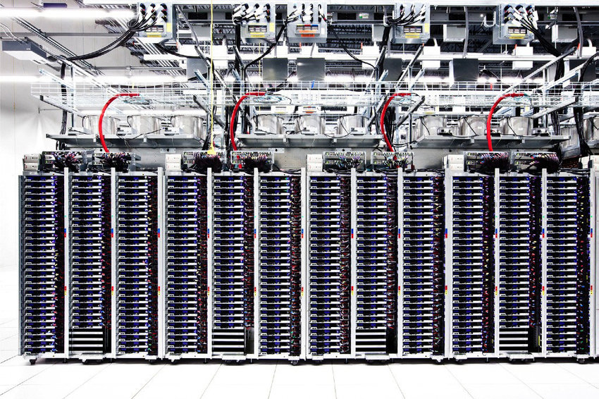
A Row of Servers in a Google Data Center
Src: the datacenter as a computer – an introduction to the design of warehouse-scale machines

Slide 13
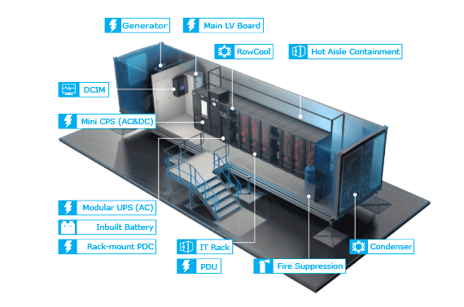
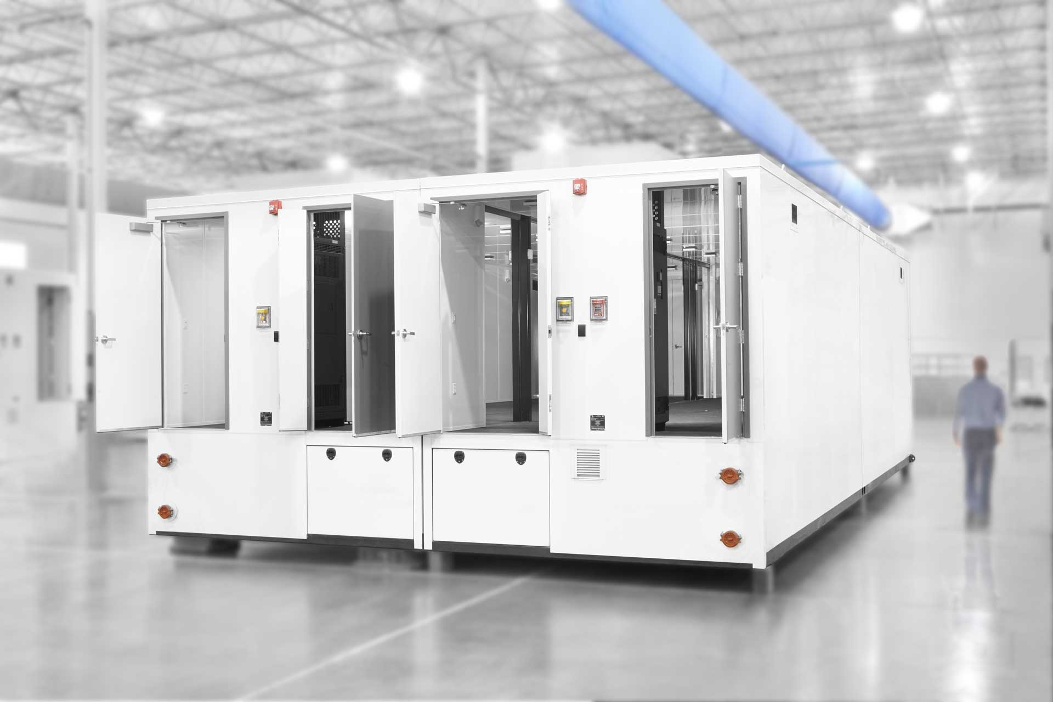
Inside a modern data center
Today’s DC use shipping containers packed with 1000s servers each.
For repairs, whole containers are replaced.

Slide 14
Costs for operating a data center
DCs consume 3% of global electricity supply (416.2 TWh > UK’s 300 TWh)
DCs produce 2% of total greenhouse gas emissions
DCs produce as much CO2 as The Netherlands or Argenti
Monthly cost = $3’530’920
31% power

Slide 15
Power Usage Effectiveness (PUE)
PUE is the ratio of
The total amount of energy used by a DC facility
To the energy delivered to the computing equipment
PUE is the inverse of data center infrastructure efficiency
Total facility power = covers IT systems (servers, network, storage) + other equipment (cooling, UPS, switch gear, generators, lights, fans, etc.)
Notes:
Industry standard

Slide 16
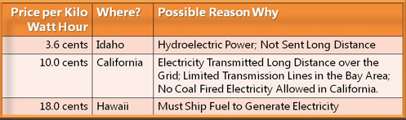
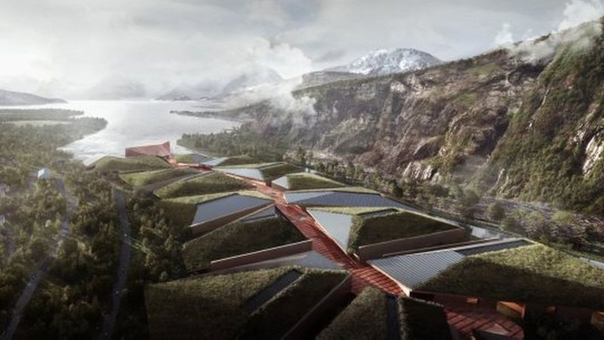
Achieving PUE
Location of the DC – cooling and power load factor
Raise temperature of aisles
Usually 18-20 C; Google at 27 C
Possibly up to 35 C (trade off failures vs. cooling costs)
Reduce conversion of energy
E.g., Google motherboards work at 12V rather than 3.3/5V
Go to extreme environments
Arctic circle (Facebook)
Floating boats (Google)
Underwater DC (Microsoft)
Reuse dissipated heat

Slide 17
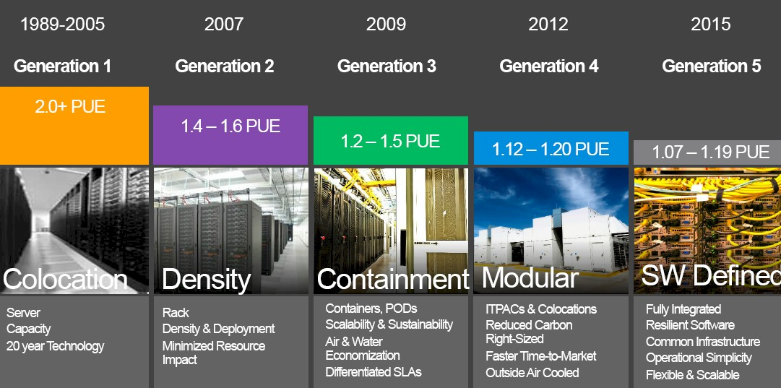
Evolution of data center design
Case study: Microsoft
https://www.nextplatform.com/2016/09/26/rare-tour-microsofts-hyperscale-datacenters/
Notes:
To backstep a little bit, between 1989 and 2005, with the first generation of co-located datacenters that Microsoft paid for, the company bought generic servers from the big tier one suppliers and racked them and stacked them like every other enterprise company of the client/server and dot-com eras did. With these facilities, which had traditional raised floors used in datacenters for decades, the power usage effectiveness of the datacenter – a measure of efficiency that is the total power of the datacenter divided by the total power of the IT gear – was at best around 2.0 and in some cases as high as 3.0. So, that meant for every 1 megawatt of juice consumed by the IT gear doing actual work there was another 1 megawatt of electricity being consumed by the datacenter as voltages were stepped down for battery backup and the gear in the racks and water was chilled and air blown around the datacenter.
Starting in 2007 with the Columbia 1 datacenter in Quincy and then adding on with the Columbia 2 facility in 2008, which together are the size of a dozen American football fields, Microsoft started using rack-dense system configurations. Each of the datacenters has five rooms with 18 rows of racked up gear. Each room is rated at 2.5 megawatts, and across those ten rooms with the networking and other gear thrown in, the whole thing draws 27.6 megawatts. With the compute density and improved cooling, Microsoft was able to get the PUE of its Generation 2 datacenters down to between 1.4 and 1.6, which means the power distribution and cooling were only adding 40 percent to 60 percent on top of the juice burned by the IT gear itself. This was a big improvement.
With the Generation 3 datacenters that Microsoft rolled out in 2009, it took on the issue of containing the heat in the datacenter. In some cases with the Generation 3 datacenters the containment came literally from containers – in this case, shipping containers, and with some of the Microsoft locations (such as those used in its Chicago facilities), the containers were double stacked and packed with gear. (See here for more details on this.) Microsoft experimented with different designs to contain heat and drive down PUE, including hot aisle containment and air-side economization, which drove the PUE down as low as 1.2.
“In Generation 4, we learned a few things,” said Bakken. “First, buy the datacenter as a box with a single part number. These integrated modules can either be deployed in a container-like structure, which we call an ITPAC, or a more conventional co-lo design. At the same time we moved away from chiller environments and into chiller-less environments that use outside air for cooling — also known as air-side economization — where it was appropriate. Thsi drove our PUE ratings down to the range of 1.12 to 1.2, below our previous designs and far below the industry.”
This is something that is possible in a town like Quincy, where the temperature only rose above 85 degrees for 21 days in the past year.
With the ITPACs, which were manufactured by two different vendors, Microsoft told them that it wanted containerized units of datacenter that would take 440 volt power in and have a plug for the network and run several thousands of servers in a pod. Microsoft did not care how they did it so long as it met the specs and could be rolled into the datacenter. As it turns out, the two vendors had very different designs, with one creating a pod that had a shared hot aisle in the center and two rows of gear on the outside and the other creating a pod that had separate hot and cold aisles. These pods were lifted into a datacenter with a crane and then the roof was put onto the building afterwards, and interestingly, the first day that they went in it snowed like crazy in Quincy and the snow blew in through the side walls and surrounded the pods. (Microsoft eventually put up baffle screens to keep the rain and the snow out but let the wind in.)
Over the years, Microsoft has done a few tweaks and tunings with the Generation 4 datacenters, including getting rid of large-scale uninterriptible power supplies and putting small batteries inside servers instead. After realizing what a hassle it was to have a building with walls and a roof and that it took too long to get the ITPAC pods into the facility, Microsoft went all the way and got rid of the building. With one Generation 4 facility that was built in Quincy, the pods stand in the open air and the network and power are buried in the concrete pad they sit upon. And with a Generation 4 facility in Boydton, Virginia, Microsoft deployed adiabatic cooling, where air is blown over screens soaked with water in the walls of the datacenter to create cool air through evaporation of the water rather than using simple outside air cooling alone. (Facebook uses variations of this adiabatic cooling technology in its Forrest City, North Carolina facility.)
he Generation 5 datacenters would use 48U (84-inch) tall racks. It looks like there are 20 racks to a row by our count, and at 84 inches that gives you four of the 12U Open Cloud Server enclosures per rack, and that works out to 96 server nodes per rack. The funny bit is that the machines on the left of this image look like the Open Cloud Server, but the ones on the right do not. They look like a different modular blade form factor, and perhaps Microsoft is cooking up a different Open Cloud Server to donate to the Open Compute Project? That looks like seven vertical nodes in a 4U enclosure to our eyes, which would yield a maximum of 84 sleds per node. (These don’t appear to be packed that densely and have other gear in the racks.)
The first Generation 5 maintenance zone has been released to engineering to be populated by servers. The Generation 5 datacenters have lots of power, at 10.5 megawatts each, 42 megawatts for a maintenance zone, and 168 megawatts for the theater of four zones, which Microsoft could build some day but has not committed to do so as yet.

Slide 18
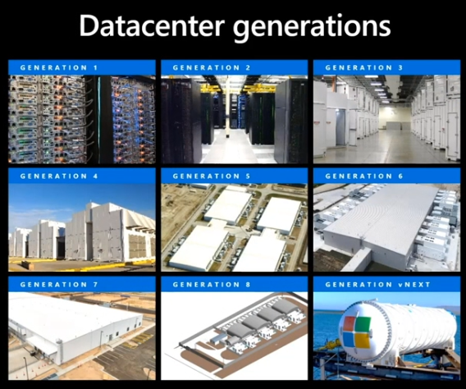
Evolution of datacenter design
Gen 6: scalable form factor (2017)
Reduced infrastructure, scale to demand
1.17-1.19 PUE
Gen 7: Ballard (2018)
Design execution efficiency
Flex capacity enabled
1.15-1.18 PUE
Gen 8: Rapid deploy datacenter (2020)
Modular construction and delivery
Equipment skidding and preassembly
Faster speed to market
Project Natick (future) – 1.07 PUE or less
Src: Inside Azure Datacenter Architecture with Mark Russinovich
Project Natick: (future) rapid deployment, close to population centers, high energy density, resistant to hurricanes, solar storms, earthquake, 1.07 or less PUE
Notes:
Instead of generating the large hyper-scale 32MW/h datacenters, they moved to creating smaller units of datacenters that could be composed to create larger units, but also more agile when deploying elsewhere. In addition, that enabled them to become even more efficient.
Gen 7, was deployed until last year, they simplified the design the electrical system, by intelligent monitoring and software throttling of power usage, etc.

Slide 19
Datacenter Challenges

Slide 20
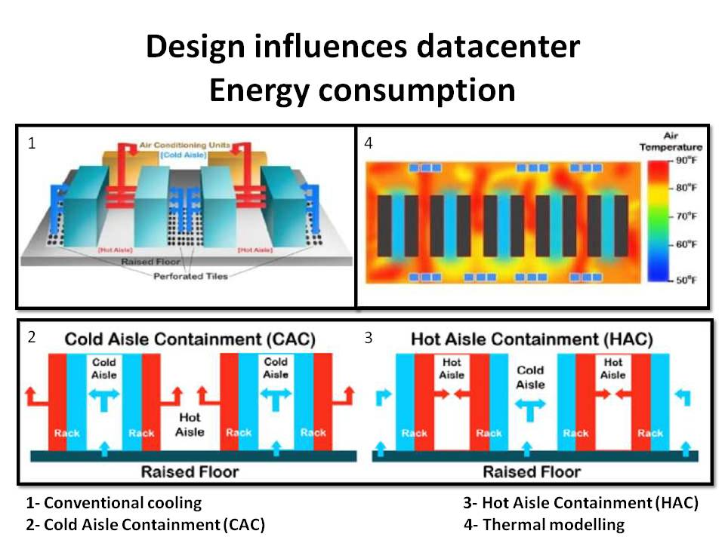
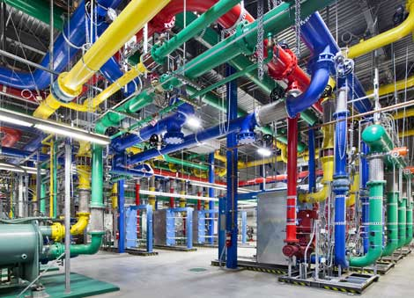
Challenge 1: Cooling data centers
Cooling plant at a Google DC in Oregon

Slide 21
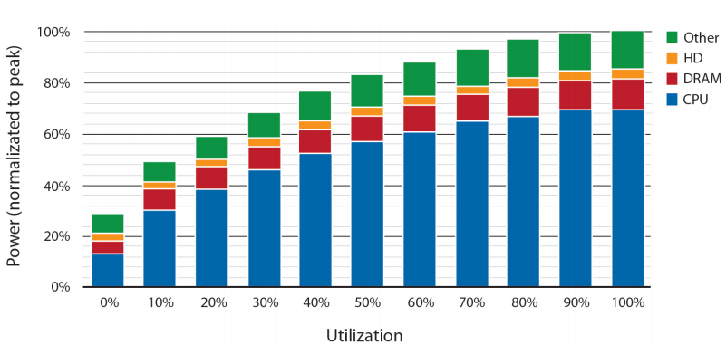
Challenge 2: Energy Proportional Computing
Average real world DC and servers are too inefficient.
waste 2/3+ of their energy
Energy consumption is not proportional to the load
CPUs are not so bad but the other components are
CPU is the dominant energy consumer in servers – using 2/3 of energy when active/idle.
Try to optimize workloads
Virtualization and consolidation.
Sub-system power usage in an x86 server as the compute load varies from idle to full (reported in 2012).
src: “The Datacenter as a Warehouse Computer”

Slide 22
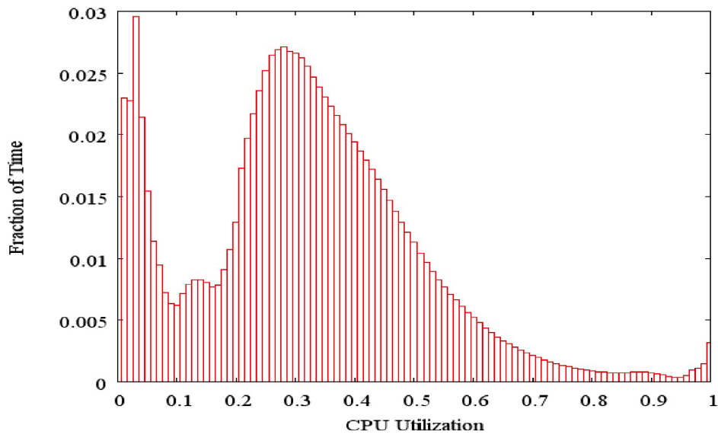
Challenge 3: Servers are idle most of the time
For non-virtualized servers 6-15% utilization
Server virtualization can boost to an average 30% utilization
Need for resource pooling and application and server consolidation
Need for resource virtualization
src: Luiz Barroso, Urs Hölzle “The Datacenter as a Computer”
Notes:
Traditional datacenters typically build dedicated infrastructures for each workload. Server virtualization has helped break down some of these silos, but in practice this technique can be applied only to a portion of enterprise workloads.
Software defined datacenters provide the ability to rapidly match workloads with hardware components from a common pool of infrastructure components.

Slide 23
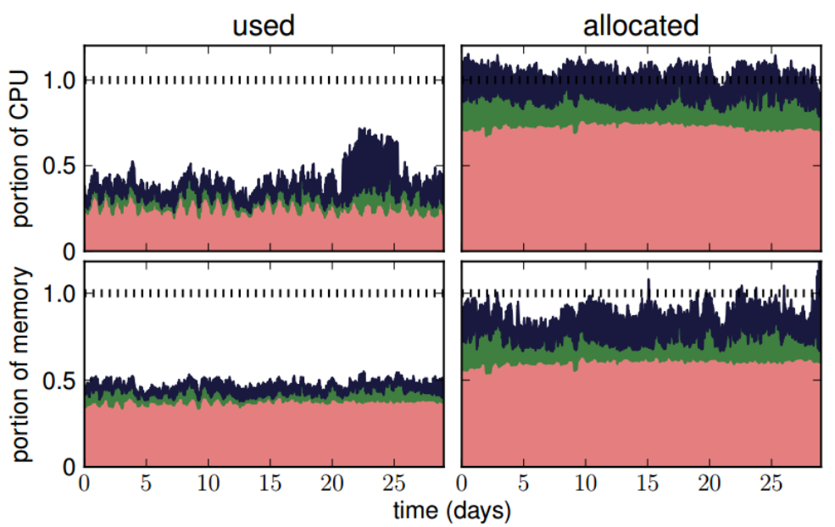
Challenge 4: Efficient monitoring
Even with virtualization and software defined DC, resource utilization can be poor.
Need for efficient monitoring (measurement) and cluster management.
Goal to meet SLOs and SLIs.
Job’s tail latency matters!
src: “Heterogeneity and dynamicity of clouds at scale: Google trace analysis” SoCC’12

Slide 24
Improving resource utilization
Hyper-scale system management software
Treat the datacenter as a warehouse scale computer
Software defined datacenters
System software that allows DC operations to manage the entire DC infrastructure
Compose a system using pooled resources of compute, network, and storage based on workload requirement
Dynamic resource allocation
Virtualization is not enough to improve efficiency
Need the ability to dynamically allocate CPU resources across servers and racks, allowing admins to quickly migrate resources to address the shifting demand
Drive 100-300% better utilization for virtualized WLs, and 200-600% for bare-metal WLs.

Slide 25
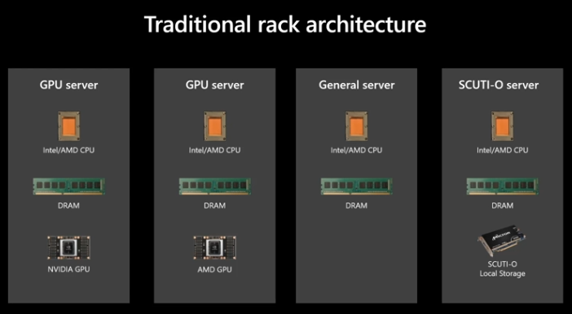
Software defined DCs
Src: Inside Azure Datacenter Architecture with Mark Russinovich

Slide 26
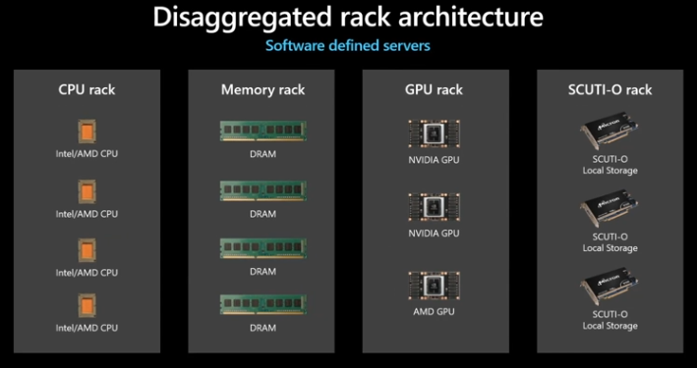
Disaggregation across racks
Src: Inside Azure Datacenter Architecture with Mark Russinovich

Slide 27
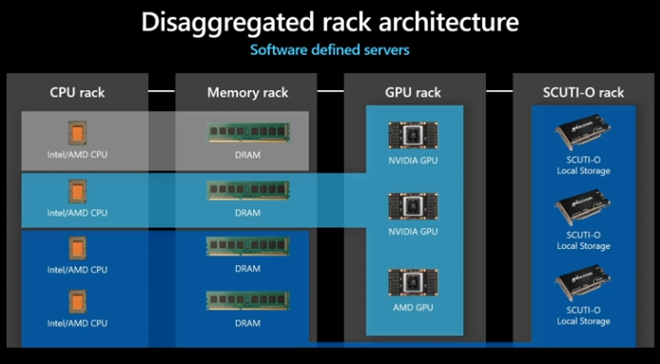
Software defined Servers
Src: Inside Azure Datacenter Architecture with Mark Russinovich

Slide 28
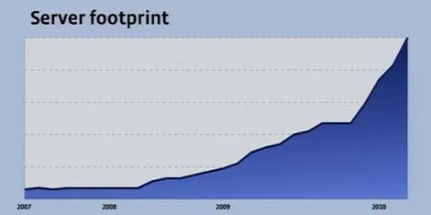

Challenge 5: Managing scale and growth
In 2016, Gartner estimated that Google has 2.5 million servers
In 2017, Microsoft Azure was reported to have more than 3 million servers.
200,000+ servers (estimated)

Slide 29
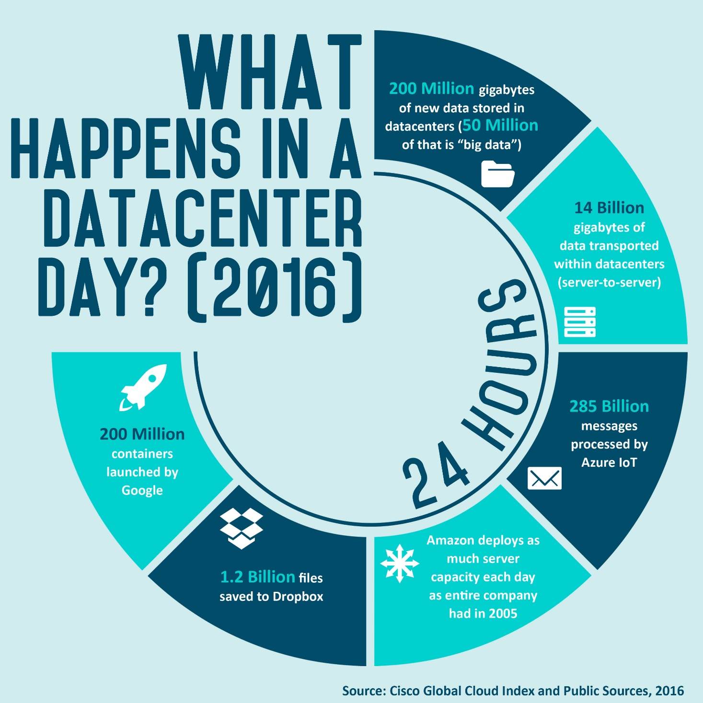
Size and growth of DC (2016-2020)
The scale and complexity of DC operations grows constantly.
By 2020, Cisco estimated that we would have 600 million GB of new data saved each day (200 million GB big data)
So the volume of BigData by 2020 was estimated to be as much as all of the stored data in 2016.

Slide 30
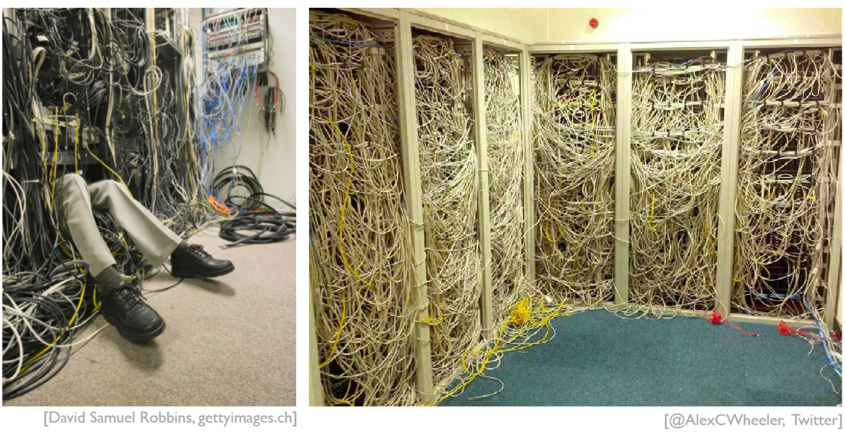
Challenge 6: networking at scale

Slide 31
Challenge 6: networking at scale (cont.)
Building the right abstractions to work for a range of workload at hyper-scale.
Software Defined Networking (SDN)
Within DC, 32 billion GBs will be transported in 2020
src: Cisco’s report 2016-2020
“Machine to machine” traffic is orders of magnitude larger than what goes out on the Internet
Src: Jupiter Rising: A Decade of Clos Topologies and Centralized control in Google’s Datacenter network (ACM SIGCOMM’15)

Slide 32
Cloud Computing Overview

Slide 33
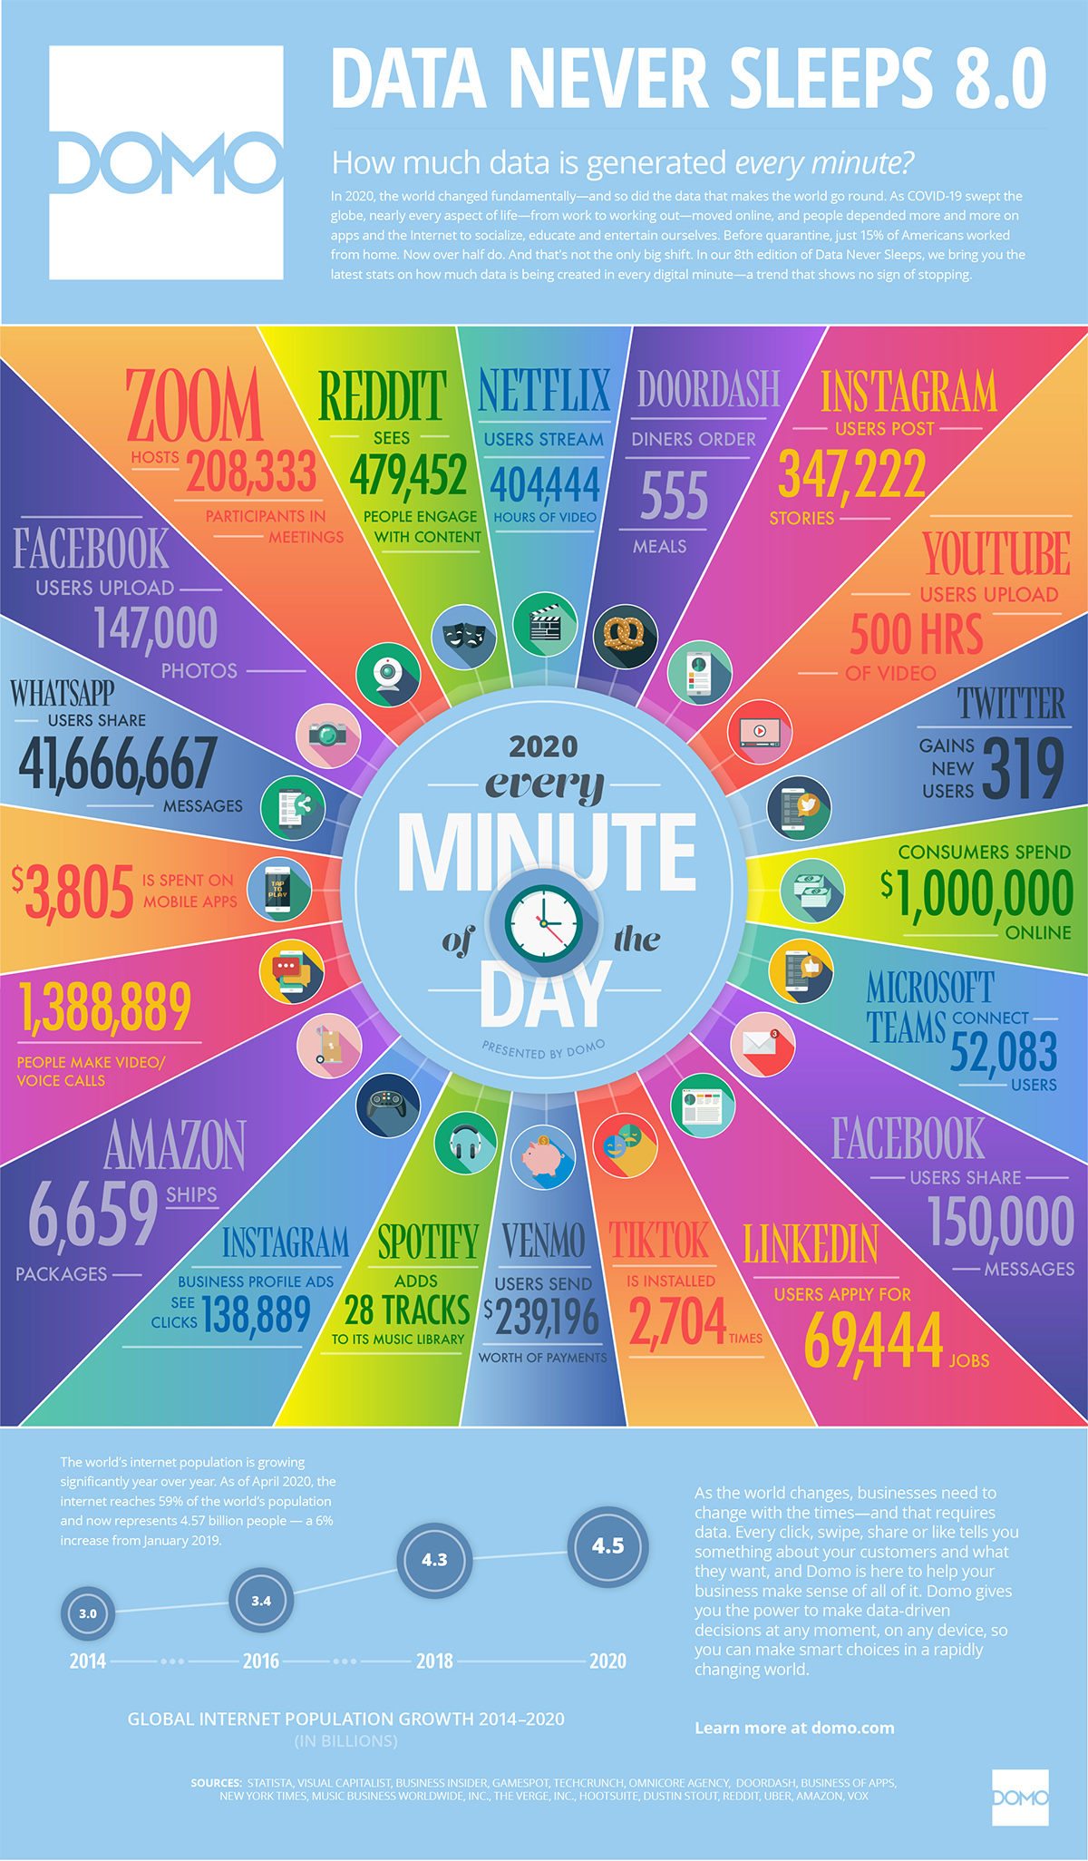
Big Data and the need for Cloud
https://www.visualcapitalist.com/every-minute-internet-2020/
Notes:
There are many challenges:
How do we store this data?
How do we share it, analyse it, search it?
But also transfer it
Secure it
Keep it running with high availability
All of this is, unfortunately, not possible with traditional IT systems.

Slide 34
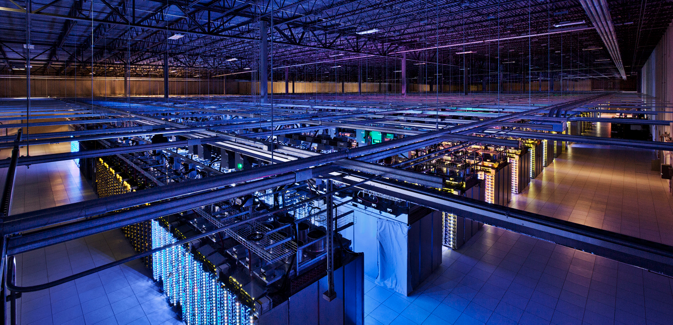


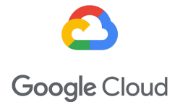
Cloud and Cloud computing
Datacenter hardware and software that the vendors use to offer the computing resources and services.
The cloud has a large pool of easily usable virtualized computing resources, development platforms, and various services and applications.
Cloud computing is the delivery of computing as a service.
The shared resources, software, and data are provided by a provider as a metered service over a network.

Slide 35
Cloud Computing
Datacenters are vendors that rent servers or other computing resources (e.g., storage)
Anyone (or company) with a “credit card” can rent
Cloud resources owned and operated by a third-party (cloud provider).
Fine-grained pricing model
Rent resources by the hour or by I/O
Pay as you go (pay for only what you use)
Can vary capacity as needed
No need to build you own IT infrastructure for peak loads

Slide 36
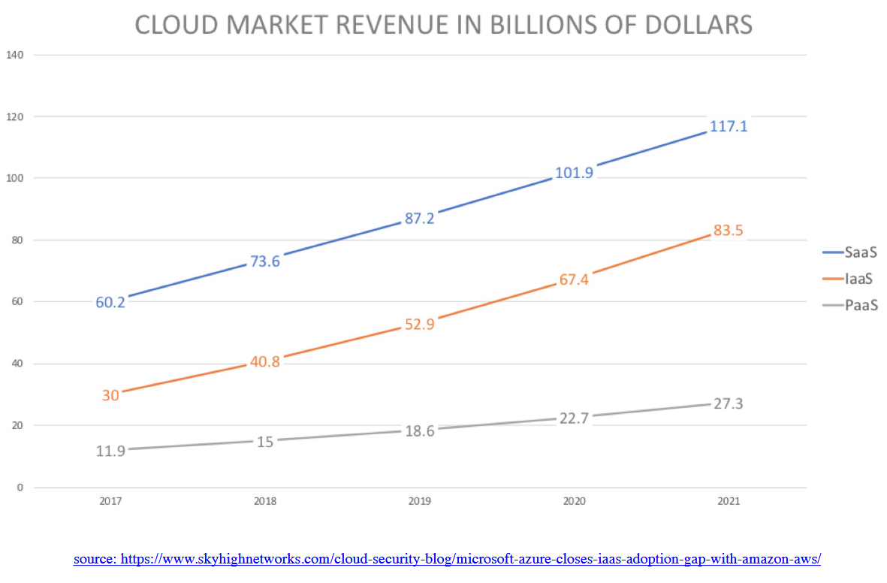
Cloud market revenue in billions of dollars

Slide 37
Cloud Roles
SaaS user
Application users
Cloud Users
Software / websites that serve real users
Netflix, Pinterest, Instagram, Spotify, AirBnb, Lyft, Slack, Expendia
Data analytics, machine learning, and other data services
Databricks, Snowflake, GE Healthcare
Mobile and IoT backends
Snapchat, Zynga (AWS → zCloud → AWS)
Datacenter’s own software
Google Drive/One Drive, search, etc.
Cloud Providers
Companies with large DCs
Amazon AWS, Microsoft Azure, Google Cloud Platform, Alibaba Cloud, …
Web applications
SaaS Provider / Cloud user
Utility computing
Cloud Provider

Slide 38
Types of Cloud Computing
Public vs. Private
Public: resources owned and operated by the one organization aka the cloud vendor
Private: Resources used exclusively by a single business or organization
On-premise vs. Hosted:
On-premise (on-prem): resources located locally (at a datacenter that the organization operates)
Hosted: resources hosted and managed by a third-party provider
Private cloud can be both on-prem and hosted (virtual private cloud)

Slide 39
Types of Cloud Computing (cont)
Hybrid cloud
Combines public and private clouds, allows data and applications to be shared between them.
Better control over sensitive data and functionalities
Cost effective, scales well and is more flexible
Multi-Cloud
Use multiple clouds for an application / service
Avoids data lock-in
Avoids single point of failure
But, need to deal with API differences and handle migration across clouds

Slide 40
Cloud service models (XaaS)
more
Infrastructure as a Service (IaaS)
Rent IT infrastructure – servers and virtual machines (VMs), storage, network, firewall, and security
Platform as a Service (PaaS)
Get on-demand environment for development, testing and management of software applications: servers, storage, network, OS, databases, etc.
Serverless, Function as a Service (FaaS)
Overlapping with PaaS, serverless focuses on building app functionality without managing the servers and infrastructure required to do so.
Cloud vendors provides set-up, capacity planning, and server management.
Software as a Service (SaaS)
Deliver software applications over the Internet, on demand.
Cloud vendor handles software application and underlying infrastructure
control
less

Slide 41
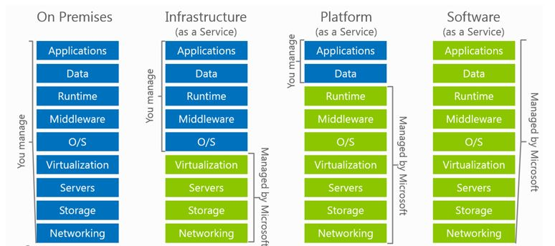
Infrastructure as a Service
Immediately available computing infrastructure, provisioned and managed by a cloud provider.
Computing resources pooled together to server multiple users / tenants.
Computing resources include: storage, processing, memory, network bandwidth, etc.
Managed by user
cloud provider
src image from Microsoft Azure
Notes:
Infrastructure as a service (IaaS) is an instant computing infrastructure, provisioned and managed over the Internet.
Quickly scale up and down with demand, and only pay for what you use.
IaaS helps to avoid the expense of buying and managing your own physical servers and other data centre infrastructure. Each resource is typically offered as a separate service component (which you would need to pay for only if you need it and use it).
The cloud provider manages the infrastructure, while the user is responsible for purchasing, installing, configuring and managing their own software (operating systems, middleware, application, etc.).
Common scenarios:
Test and development
Website hosting
Storage, back-up and recovery.
Web apps – infrastructure to support web apps including storage, web and application servers, and networking resources. Organisations can easily deploy web apps and scale the infrastructure up and down when the demand for the app is unpredictable.
High-performance computing – doing computations that require enormous computing power from time to time will be more economical to do in a pay-as-you-go cloud setting. Not always the best performing though, why?
Big data analysis – analyzing data to get valuable insights, trends, patterns often requires huge amount of processing power, which the IaaS can provide (again) economically.
Advantages of IaaS:
Eliminates capital expense and reduces ongoing costs. Similar for maintenance and IT management.
Improves business continuity and disaster recovery (high availability, reliability, fault tolerance).
Fast and on-demand get new resources.
Respond more quickly to shifting business conditions – flexibility to easily scale up and down the resources to accommodate spikes in demand for your application.
Potentially better security (depending on the SLA you’ve signed with the cloud vendor)

Slide 42
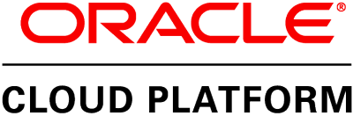
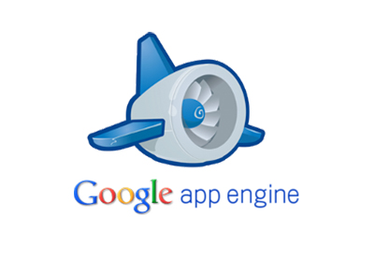
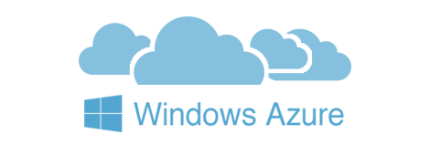
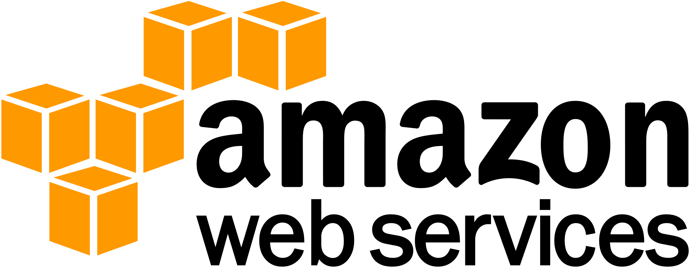
Platform as a Service
Complete development and deployment environment.
Includes system’s software (OS, middleware), platforms, DBMSs, BI services, and libraries to assist in development and deployment of cloud-based applications.
Examples:
What is serverless computing then?
user
Managed by cloud provider
src image from Microsoft Azure
Notes:
PaaS allows you to avoid the expense and complexity of buying and managing software licenses.
Common PaaS scenarios:
Development framework
Analytics or business intelligence.
Additional services: workflow, directory, security and scheduling.
Serverless computing is the abstraction of servers, infrastructure and operating systems. When you build serverless applications you do not need to provision and manage any servers, so you can take your mind off infrastructure concerns.
Why serverless?
Benefit from fully managed services – deploy code and it runs with high availability without you or your team having to be burdened with the management of the infrastructure.
Serverless compute scales from nothing to tens of thousands of concurrent functions within seconds to match any workloads (without requiring you to scale configuration – it reacts to events and triggers in near-real time).
You only pay for the time your code is running. Serverless computing is event-driven, and resources are allocated as soon as they are triggered by an event. You are only charged for the time and resources it takes to execute your code.
Examples of serverless:
Web application architecture.
IoT back-end. IoT devices send messages to stream analytics, which then calls a cloud function to transform the message.
SaaS integration.
Azure for serverless applications.
Compute – functions is an event-driven compute experience that allows you to execute your code, written in the programming language of your choice, without worrying about the servers. Benefits from scale on demand and never pay for idle capacity.
Storage – durable, highly available, and massively scalable storage for developers of cloud applications.
Databases
Security and access control
Cloud messaging
Workflow orchestration
API management
Analytics – Azure stream analytics, Event hub
Intelligence
Etc.

Slide 43
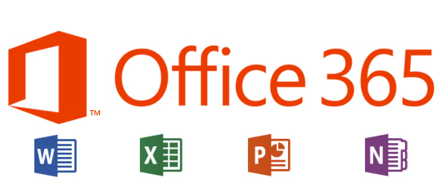
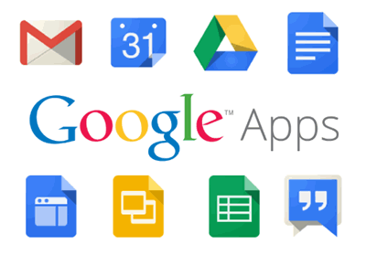
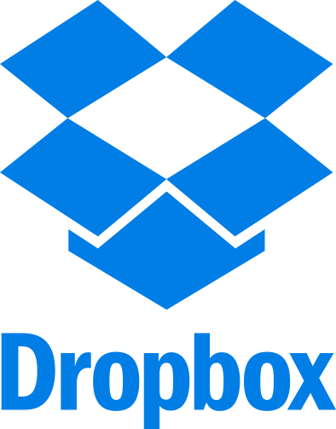
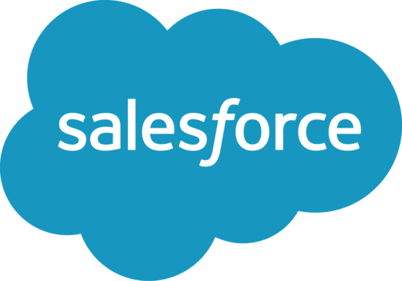

Software as a Service
Notes:
SaaS allows users to connect to and use cloud-based apps over the Internet.
Common examples are email, calendaring and office tools.
The cloud provider manages the hardware and software, and with the appropriate
Service agreement, will ensure the availability and the security of the app
And your data as well.
Common SaaS scenarios:
Personal use free services (web-based email, etc.)
For organizational use you can ren (monthly/yearly subscription) apps such as email collaboration tools, sophisticated business applications such as CRM, ERP and document management applications.
Advantages:
only pay for what you use
Free client software
Access app data from everywhere
Easy access to sophisticated applications without the outright cost for hosting and managing them.

Slide 44
Cloud pros and cons
User’s benefits:
Elimination of up-front commitment
Speed – services are provided on demand
Global scale and elasticity
Productivity
Performance and security
Customizability
Ability to pay for use of computing resources on a short-term basis (as needed)
User’s concerns:
Dependability on network and internet connectivity
Security and privacy
Cost of migration
Cost and risk of vendor lock-in
Notes:
Cost – cloud computing eliminates the capital expense of buying hardware and software, and setting up and running on-site data centers – the racks of servers, the round-the-clock electricity for power and cooling, the IT experts for managing the infrastructure.
Speed – most cloud computing services are provided as self-service and on demand, so even vast amounts of computing resources can be provisioned in minutes, typically with just a few mouse clicks away. Giving businesses a lot of flexibility and taking the pressure off capacity planning.
Global scale and elasticity – the ability to scale elastically. In cloud speak, that means delivering the correct amount of IT resources – more or less computing power, storage, bandwidth – when it’s needed, and from the correct geographic location.
Productivity – on-site data centers typically require a lot of “racking and stacking” – hardware setup, software patching, and other time consuming IT management chores. Cloud computing removes the need for many of these tasks, so IT teams can spend time on achieving more important business goals.
Performance – regular upgrades to latest generation of fast and efficient computing hardware. Reduced network latency for applications and greater economies of scale.
Security – many cloud providers offer a broad set of policies, technologies, and controls that strengthen your security posture overall, helping to protect your data, apps and infrastructure from potential threats.

Slide 45
References
In addition to the cross references provided in the slides.
Some material based on:
Lecture notes from “Scalable Systems for the Cloud” by Prof. Giceva at Imperial
Lecture notes from “Modern Data Center Systems” by Prof. Zhang at UC San Diego
Book “The Datacenter as a Computer – An Introduction to the Design of Warehouse-scale Machines” by Luiz Andre Barroso, Jimmy Clidaras, Urs Holzle
Talk “Inside Azure Datacenter Architecture” with Mark Russinovich (Azure CTO)
Paper “Above the Clouds: A Berkeley View of Cloud Computing”
Web-pages from Amazon AWS, Microsoft Azure and Google CDP

